Slide 1
AI-Driven Hand Gesture Recognition
Team Guide:
Mr. R. Raja Subramanian

Slide 2

Objective
The main objective of this project is to look for new ways to combine traditional radar signal processing techniques with Data-Driven approaches to provide a better hand gesture recognition model and to conduct a literature review on hand gesture recognition using radar sensors, machine learning and deep learning.

Slide 3
Literature Survey on Gesture Recognition
Survey Team:
Yashwanth
Mathan
Deepika Duggirala
Harini Mohan

Slide 4
Radar Based Gesture Recognition
Hand Gesture Recognition using a Three-dimensional 24 GHz Radar Array
Gesture recognition system based on ultrasonic FMCW and ConvLSTM model.
Sign Language Gesture Recognition using Doppler Radar and Deep Learning
Gesture recognition of radar micro doppler signatures using separable convolutional neural networks
MDHandNet: a lightweight deep neural network for hand gesture/sign language recognition based on micro-doppler images
Radar-Based Hand Gesture Recognition Using Spiking Neural Networks

Slide 5
Literature Survey
Title | Journal/Year | Approach | Description
Hand Gesture Recognition using a Three-dimensional 24 GHz Radar Array | IEEE/MTT-S International Microwave Symposium – IMS 2018 | Frequency Modulated Continuous Wave (FMCW) radar is able to detect the frequency shift between the transmitted and received electromagnetic wave according to Doppler Effect. | The recognition system is implemented on a radar array consisting of three continuous wave radar operating at 24.125 GHz. A decision tree algorithm is constructed and evaluated as the classifier in the experiment. gesture motions are consequently recorded in the radar signal frequency spectra according to Doppler Effects. This system has a better performance in recognizing the in-plane motion than flexion and extensions and achieved a high recognition accuracy rate higher than 92%.

Slide 6
Literature Survey
Title | Journal/Year | Approach | Description
Gesture recognition system based on ultrasonic FMCW and ConvLSTM model. | Measurement Volume 190, 28 February 2022 | Ultrasonic frequency modulated continuous wave (FMCW) and ConvLSTM model. | One transmitter and three receivers spatially installed at different directions. An FMCW signal emitted by the transmitter would be detected by the receivers after reflecting from the hand. Then, the range-Doppler maps (RDMs) of the received signal were obtained by processing 2D fast Fourier transform. A fine resolution of 0.005 m in distance and 0.03 m/s in velocity for hand movement, and an accuracy of 85.7% with a small size of 50 samples training for finger-movement gestures are achieved.

Slide 7
Literature Survey
Title | Journal/Year | Approach | Description
Sign Language Gesture Recognition using Doppler Radar and Deep Learning | IEEE Globecom Workshops 2019 | DCNN and VGG-16 algorithm | ASL hand gesture motions are captured as micro-Doppler signals using a microwave X-band Doppler radar transceiver these hand gestures are analyzed using MATLAB. DCNN algorithm is used to train those ASL gestures depicted by the spectrograms. The average validation accuracy of DCNN and VGG-16 algorithms were 87.5% and 95%, respectively.

Slide 8
Literature Survey
Title | Journal/Year | Approach | Description
Gesture Recognition with a Low Power FMCW Radar and a Deep Convolutional Neural Network | European Radar Conference (EURAD), October 2017 | FMCW radar and a deep convolutional neural network (DCNN) | The FMCW radar operates in the 24 GHz ISM frequency band and has an effective isotropic radiated power level of 0 dBm, the FMCW radar has only one receive channel. The recognition of gestures is performed with a deep convolutional neural network that is trained and tested with micro-Doppler spectrograms. After training and validation, both methods provided 99 % classification accuracy on the test set.

Slide 9
Literature Survey
Title | Journal/Year | Approach | Description
Efficient Convolutional Neural Network for FMCW Radar Based Hand Gesture Recognition | Association for Computing Machinery New York NY United States, 2019 | FMCW radar, signal processing, Convolutional Neural Network (CNN) | The sequences of the object’s range, speed, and azimuth information were merged into a single input, then feed to a convolution neural network to learn spatial and temporal patterns. VGG-10 converged at the 10th epoch with a validation accuracy of 92%. . ResNet20 outperforms VGG-10 achieving 98% validation accuracy. CNN+LSTM has the lowest accuracy on LEFT/RIGHT, due to lack of Angle-Of-Arrival information, the model achieves 98% average accuracy on the test set.

Slide 10
Literature Survey
Title | Journal/Year | Approach | Description
Automatic Radar-based Gesture Detection and Classification via a Region-based Deep Convolutional Neural Network | Conference Paper-IEEE International Conference on Acoustics, Speech and Signal Processing (ICASSP), May 2019 | Faster-RCNN, FMCW radar | A region-based deep convolutional neural network (R-DCNN) is proposed to detect and classify gestures measured by a frequency-modulated continuous-wave radar system. Along with the µD signatures, we incorporate phase-difference information of received signals from an L-shaped antenna array. the input of the proposed network contains three channels, i.e., one spectrogram and two phase-difference channels. The results achieved 95% (96%) average PPV (TPR) for nine gestures.

Slide 11
Literature Survey
Title | Journal/Year | Approach | Description
Gesture recognition of radar micro doppler signatures using separable convolutional neural networks | Materials Today: Proceedings, 2021 | Dataset: DopNet dataset Radar based hand gesture dataset is used for classifying gestures. Micro doppler signatures is used as the input to the model. Approach: Separable Convolutional Neural Networks | To convolute without overfitting, the paper uses a separable convolutional neural networks model which does depth-wise convolution followed by pointwise convolution. Received 94.56% accuracy on Dop Net data. Also, the computational time is minimized by using separable convolutions.

Slide 12
Literature Survey
Title | Journal/Year | Approach | Description
MDHandNet: a lightweight deep neural network for hand gesture/sign language recognition based on micro-doppler images | World Wide Web, 2022 | Dataset: Micro Doppler Image dataset containing 15 type of sign language actions captured by measured radar echo. Approach: MDHandNet | MDHandNet model is proposed for Hand Gesture Recognition or sign language. Received accuracy of 97.1%. Compared to other methods, the proposed model has good performance, less parameters and lower computational complexity.

Slide 13
Literature Survey
Title | Journal/Year | Approach | Description
Radar-Based Hand Gesture Recognition Using Spiking Neural Networks | Electronics 2021, 10, 1405. | Dataset: Radar system, Soli dataset, Dop Net dataset Approach: Spiking Neural Networks | Signal to Spike conversion scheme is used to encode radar Doppler maps into spike trains which are fed to Spiking Neural Networks. The readout spike signal from SNN is input to different classifiers.

Slide 14
Literature Survey
Title | Journal/Year | Approach | Description
Radar Gesture Recognition System in Presence of Interference using Self-Attention Neural Network | 18th IEEE International Conference On Machine Learning And Applications (ICMLA), 2019 | Dataset: Range-Doppler images and Range-angle images in 8 different hand gestures at different time steps. Approach: The spatio-Doppler mechanism in 2D deep convolutional neural network with long short term memory (2D CNN-LSTM) | A novel unguided spatio-Doppler attention mechanism to enable hand-gesture recognition in presence of multiple humans using a low power, compact 60-GHz FMCW radar operated in 500MHz ISM frequency band.

Slide 15
Literature Survey
Title | Journal/Year | Approach | Description
Short-Range Radar Based Real-Time Hand Gesture Recognition Using LSTM Encoder | IEEE Access, vol. 7, pp. 33610-33618, 2019 | Dataset: Signal processing that generates range-Doppler map (RDM) sequences Approach: A long short-term memory (LSTM) encoder to learn the temporal characteristics of the RDM sequences | This paper proposes a real-time gesture recognition system based on a short-range radar. Range-Doppler maps of hand gestures are recognized using 2D Fast Fourier Transform. The proposed LSTM encoder receives the motion profile sequences and performs gesture recognition.

Slide 16
Literature Survey
Title | Journal/Year | Approach | Description
Hand Gestures Recognition Using Radar Sensors for Human-Computer-Interaction: A Review | Remote Sens. 2021 | Dataset: HGR images using Radar sensors | Reviews the available techniques for multi-domain hand gestures data representation for different signal processing and deep-learning-based HGR Algorithms

Slide 17
Gesture Recognition based on Image/Video Processing
Dynamic Hand Gesture Recognition Using 3D-CNN and LSTM Networks
Human hand gesture recognition with convolutional neural networks for K12 double-teachers instruction mode classroom
Hand gesture recognition via enhanced densely connected convolutional neural network
Understanding the hand gesture command to visual attention model for mobile robot navigation: service robots in domestic environment
In-situ recognition of hand gesture via Enhanced Xception based single-stage deep convolutional neural network
Leap Motion Hand Gesture Recognition Based on Deep Neural Network

Slide 18
Gesture Recognition based on Image/Video Processing (cont.)
A hand gesture action-based emotion recognition system by 3D image sensor information derived from Leap Motion sensors for the specific group with restlessness emotion problems
Vision-based hand gesture recognition using deep learning for the interpretation of sign language
Hand Gesture Recognition using Image Processing and Feature Extraction Techniques
Sign Language Recognition Using Leap Motion A Support Vector Machine Approach
Hand posture recognition with the fuzzy glove.

Slide 19
Literature Survey
Title | Journal/Year | Approach | Description
Dynamic Hand Gesture Recognition Using 3D-CNN and LSTM Networks | Computers, Materials and Continua September 2021 | Dataset: 20BN-jester dataset (Open Source – Video dataset) Approach: Combination of 3D-CNN and LSTM (deep learning) network | The proposed architecture extracts spatial-temporal information from video sequences input while avoiding extensive computation. The 3D-CNN is used for the extraction of spectral and spatial features which are then given to the LSTM for classification.

Slide 20
Literature Survey
Title | Journal/Year | Approach | Description
Human hand gesture recognition with convolutional neural networks for K12 double-teachers instruction mode classroom | Infrared Physics and technology 111, 2020 | Dataset : The infrared hand gesture image dataset which has 38,425 images. Approach: HBA system | Convolutional neural network for Double teacher mode, a non verbal approach to extract the features of the infrared hand gesture images. A robust non-linear neural network is constructed with three convolution layers. From the comparing experiments, the results demonstrate that the developed approach can estimate the hand gesture with more than 90% final accuracy.

Slide 21
Literature Survey
Title | Journal/Year | Approach | Description
Hand gesture recognition via enhanced densely connected convolutional neural network | Expert Systems with Applications 175, 2021 | Dataset : NUS hand gesture dataset, American Sign Language (ASL) datasets Approach: EDenseNet | Customized network architecture dubbed as enhanced densely connected convolutional neural network (EDenseNet) is proposed for vision-based static hand gesture recognition. The proposed EDenseNet obtains 98.50% average accuracy without augmented data, and 99.64% average accuracy with augmented data. Here augmented data refers to additional information.

Slide 22
Literature Survey
Title | Journal/Year | Approach | Description
Understanding the hand gesture command to visual attention model for mobile robot navigation: service robots in domestic environment​ | Principles and Practices Cognitive Data Science in Sustainable Computing, 2021 | Location and Mapping algorithm | First frames are being extracted from recorded video streams at different distance and position Each session consists of 300 images of 6 different classes where each class having 50 images. It portrays the feature extraction of the hand by extracting the number of objects and orientation in the object of interest. After performing the experiments, we can see that the overall accuracy of the system is 95.44% which is a very good result. Here good Threshold values play an important role for recognizing gestures.

Slide 23
Literature Survey
Title | Journal/Year | Approach | Description
In-situ recognition of hand gesture via Enhanced Xception based single-stage deep convolutional neural network​ | Expert Systems with Applications Volume 193, 1 May 2022 | MITI-HD , NUSHP-II, Senz-3D | In this paper, a Convolutional Neural Network (CNN) based Hybrid Single Stage Recognition (Hybrid-SSR) framework is proposed for real-time hand gesture recognition. The Hybrid-SSR model’s performance is evaluated with a learning rate of 0.00015 for Adam optimizer, 0.004 for RMSprop, and 0.0001 for SGD with momentum optimizer. For Hybrid ssr CNN model The obtained accuracy is 99.21 % which is robust.

Slide 24
Literature Survey
Title | Journal/Year | Approach | Description
A hand gesture action-based emotion recognition system by 3D image sensor information derived from Leap Motion sensors for the specific group with restlessness emotion problems | Microsystem Technologies, Springer, 2020 | Dataset: The 3D hand gesture point data of the input action will be obtained from the Leap Motion sensor. Approach: K-nearest neighbor (KNN) approach is adopted to be as a gesture data classifier | Leap Motion Controller(LMC) efficiently employs the two monochromatic IR cameras to computationally compare the 2D frames so that the 3D hand scene construction with 3D-(x, y, z) point data can be accurately generated. The 3D-(x, y, z) hand gesture point data of the input action will be obtained from the Leap Motion sensor. KNN with 85-dimension feature data has the averaged recognition accuracy of 80.6%, slightly superior to 80% of 78-dimension feature data

Slide 25
Literature Survey
Title | Journal/Year | Approach | Description
Leap Motion Hand Gesture Recognition Based on Deep Neural Network | Chinese Control and Decision Conference (CCDC), 2020 | Dataset: feature data is obtained by the Leap Motion Controller Approach: Deep Neural Network (DNN) and Leap Motion. | The LMC and DNN to recognize specific gestures are combined. New feature points are designed according to the bones in Leap Motion, then the training set is recorded and the DNN model is trained to make it possible to predict the new data and return to the prediction result. Embedded the Leap Motion listening code for real-time call in order to achieve the real-time monitoring effect. The recognition accuracy of the proposed model is 98%.

Slide 26
Literature Survey
Title | Journal/Year | Approach | Description
Vision-based hand gesture recognition using deep learning for the interpretation of sign language | Expert Systems with Applications, Elsevier, 2021 | Dataset: Indian sign language (ISL) gestures and American sign language (ASL) Approach: CNN specifically designed for gesture recognition. Also used VGG-11 and VGG-16. | Convolution neural network along with modified VGG-11 and VGG-16. A dataset of static gestures has been collected from multiple signers, preprocessed and fed into the proposed model of CNN for feature learning and the classification has been performed using the Softmax classifier. The highest accuracy of 99.96% and 100% is obtained by the proposed model for ISL and ASL datasets respectively.

Slide 27
Hand Gesture Recognition - Camera based dataset
Team Members:
1. Nukala Akshith
2. Dintakurthi Achuth

Slide 28
Main Objective
Problem to worked on : Hand Gesture Recognition
Deep Learning Algorithmic based Approach
Input Data: Camera based Video Input

Slide 29
Dataset Types
Image based datasets
Video based datasets

Slide 30
Image dataset Example: NUS hand posture dataset
NUS hand posture dataset consists 10 classes of postures, 24 sample images per class, which are captured by varying the position
and size of the hand within the image frame. Both greyscale and color images are available (160×120 pixels).
The hand postures are selected in such a way that the inter class variation in the appearance of the postures is less, which makes the recognition task challenging.
Video based dataset Example: EgoGesture Dataset
EgoGesture is a multi-modal large scale dataset for egocentric hand gesture recognition. This dataset provides the test-bed not only for gesture classification in segmented data but also for gesture detection in continuous data.
The dataset contains 2,081 RGB-D videos, 24,161 gesture samples and 2,953,224 frames from 50 distinct subjects.

Slide 31
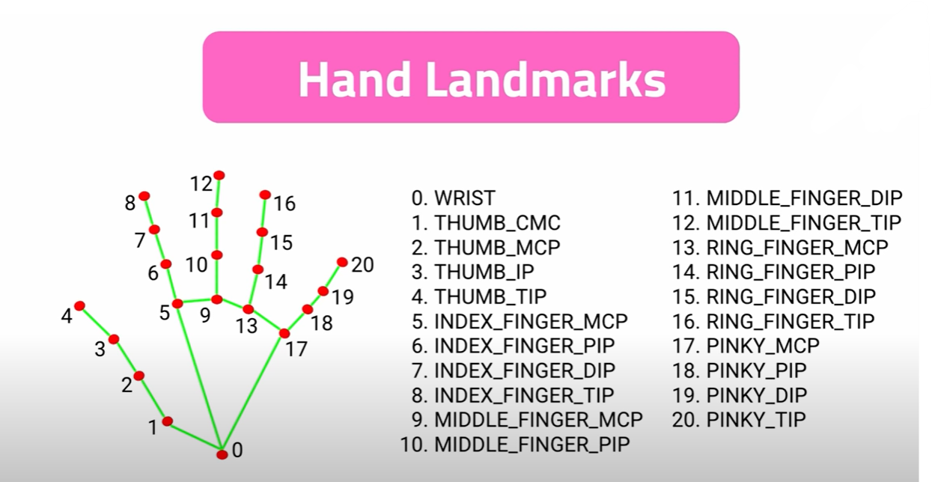
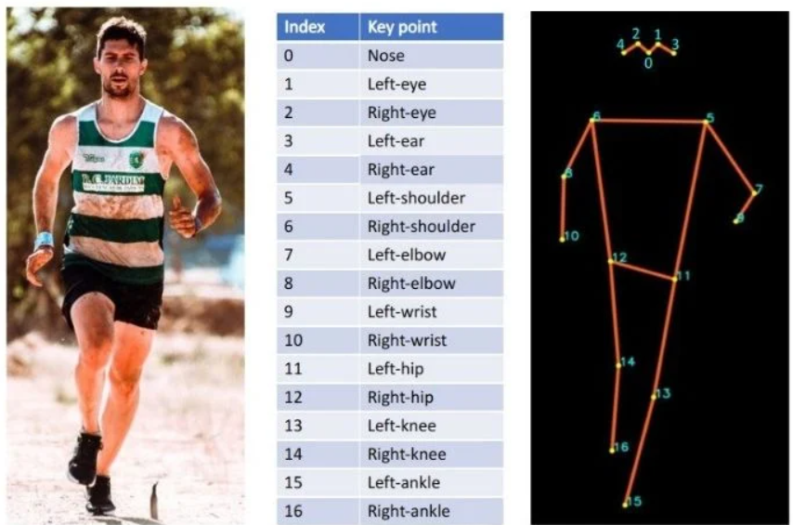
Approach 1 : Using existing support agents
Little Similarity and Comparison of
HAR problem solution – detectron
vs
Hand Gesture Recognition – Media pipe
- Simplifies problem but need to think how to
redesign the model to work on multiple objects/hands
Involvement gestures

Slide 32
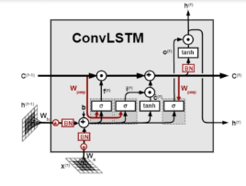
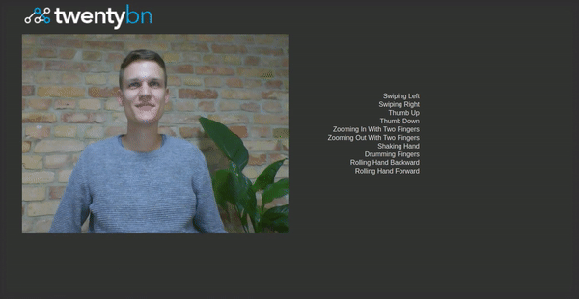
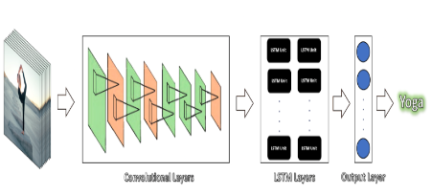
Approach 2 : LSTM & CNN
Combination of LSTM and CNN :
- helps to track the main key features of gesture recognition such as temporal and spatial features
- ConvLSTM and LRCN

Slide 33
Factors Affecting Project Implementation
FACTORS AND PROBLEMS THAT NEED TO BE SORTED OUT
Technical problems => Work environment local vs remote
Practices i.e., usage of azure / sage maker services instead of local Jupiter/collab ?
Memory exceeding => limited local / collab resources
Cpu allocation error => limited local / collab resources

Slide 34
Project Implementation Team
Team Members:
1.M Sai Murali
2.Y Sireesha

Slide 35
Deep Soli google Gesture Dataset
The dataset contains multiple preprocessed Range-Doppler Image sequences. Each sequence is saved as a single HDF5 format data file.
File names are defined as [gesture ID][session ID][instance ID].h5.
Range-Doppler Image data of a specific channel can be accessed by dataset name ch[channel ID].
Label can be accessed by dataset name label.
Range-Doppler Image data array has shape of [number of frame] * 1024 (can be reshape back to 2D Range-Doppler Image to 32 * 32)

Slide 36
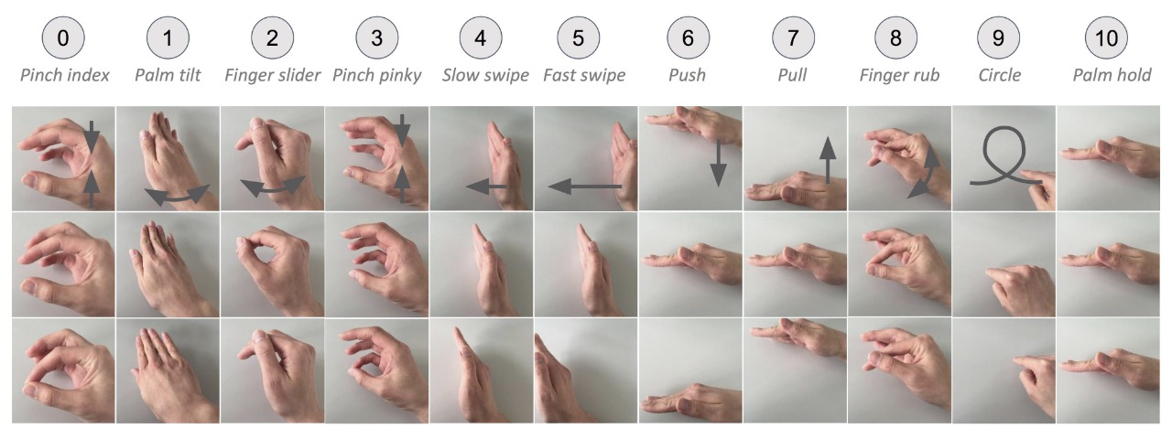
The gestures are listed in the table below.
Each column represents one gesture and we snapshot three important steps for each gestures.
The gesture label is indicated by the number in the circle above.
Please notice that the gesture label order is different than the paper, as we regroup gestures in the paper.
Sequences with gesture ID 11 are background signals with no presence of hand.

Slide 37
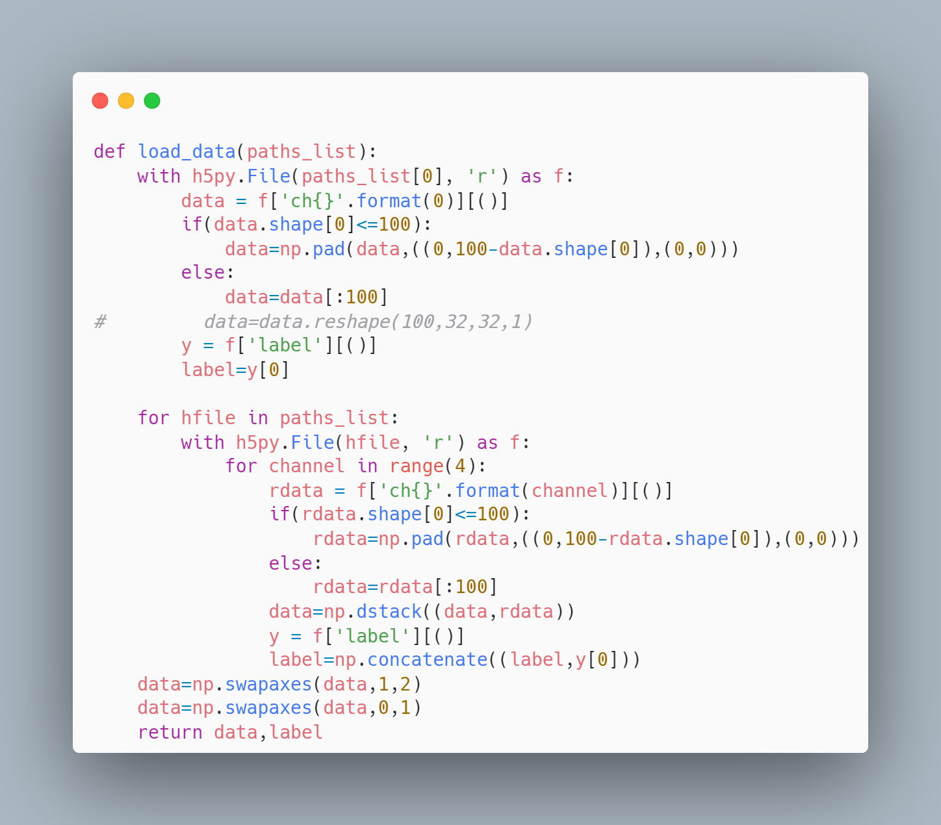
Accessing data set

Slide 38
Project Implementation
https://nextjournal.com/a/PzuPgiKRz8DeHsunpsESi?token=TtNyS3bNNvd9mN7pv7MKhX

Slide 39
Factors Affecting Project Implementation
Factors and problems that lead to failure of projects
Factors that lead to success of projects
Simplicity of design
Good management
Involvement of beneficiaries/community
Technical problems
Memory exceeding
Cpu allocation error
Unable to process the data with existing memory space.

Slide 40
THANK YOU

